Slide 1
Submitting to the NOAA Libraries: Manuscripts, Section 508, & more
Jenn Fagan-Fry
Notes:
`

Slide 2
Manuscripts Demystified
Submitted Manuscript:
Version of the publication submitted to the publisher/journal
After internal approvals, IQA, etc.
No action has been taken by publisher (i.e. HAS NOT GONE THROUGH PEER REVIEW)
Often these are referred to as pre-prints and can be found on pre-print servers.
Not the version required by the NOAA PARR plan for archiving

Slide 3
Manuscripts Demystified, cont’d
Accepted Manuscript: (also called a post-print)
Version created AFTER peer-review by the publisher, but does not include publisher added content (formatting, pagination, logos, etc.)
Author still holds rights to this version of the manuscript
Version that should be retained for archiving with the NOAA IR
Version used for Green Open Access

Slide 4
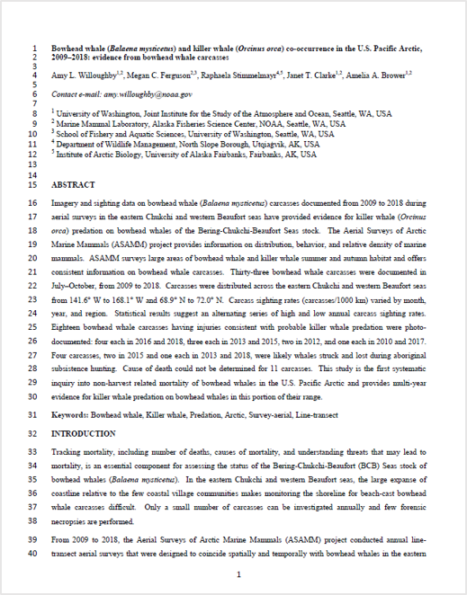
Example: https://repository.library.noaa.gov/view/noaa/29173
Lack of publisher branding, logos, color schemes, etc.
No watermarks
Looks similar to the Submitted manuscript in terms of format
BUT suggested edits from reviewers have been incorporated
Notes:
EVEN IF YOU ARE NOT THE PRIMARY AUTHOR, you should still try to obtain this version from the primary. It is your responsibility as a co-author.

Slide 5
Manuscripts Demystified, cont’d
Galley Proofs: (also called a pre-proof, etc.)
Follows the accepted manuscript, and is produced by the publisher
Used for verification and final copy-editing, typesetting, etc.
Final author review before publication
Will often feature watermarks
Publishers do not allow this version of the publication to be archived. Anywhere.

Slide 6
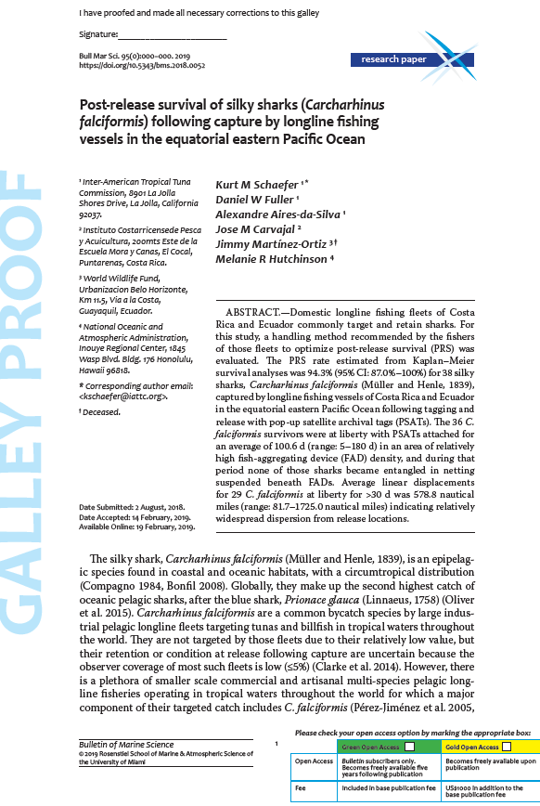
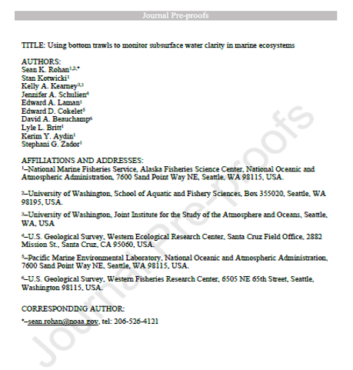
Watermarks visible
Request for verification or approval from author
Publisher formatting and branding may appear

Slide 7
Manuscripts Demystified, cont’d
Version of Record (VOR): (also called the Publisher’s version/PDF)
Authoritative, final version of the article
Version found on the publisher’s website (via DOI)
Includes publisher logos, formatting, paginations, etc.
Depending on publisher/journal permissions, this version can sometimes be archived, but generally is only available via the publisher’s website

Slide 8
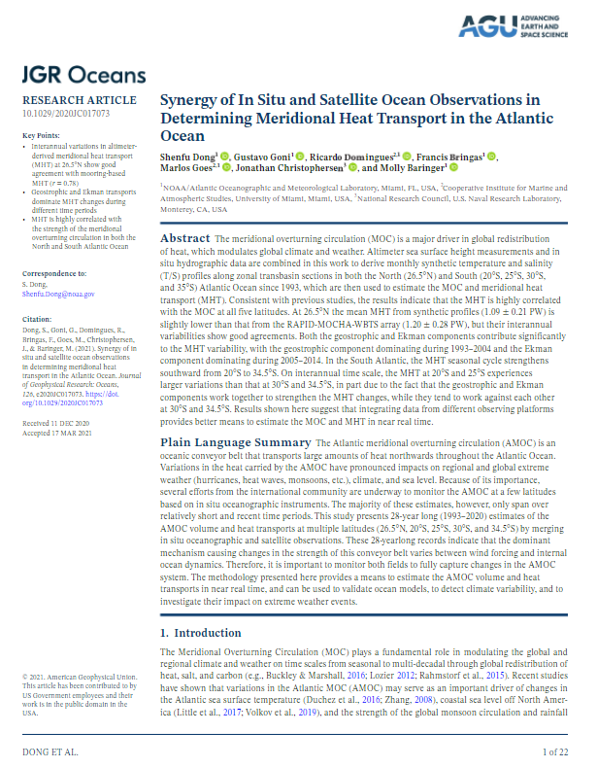
Journal name/branding
Copyright statement available
Final formatting, pagination, etc.
Citation information
Copyright statement

Slide 9
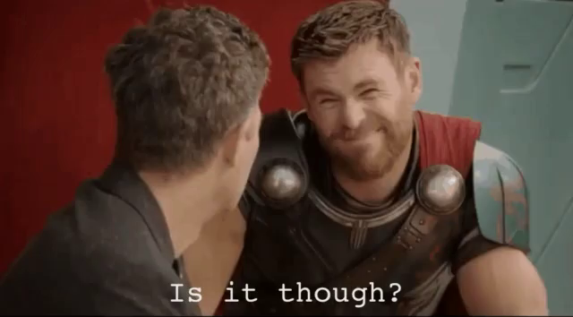
Identifying OA Articles
Notes:
Sounds easy, I know—but it can get really tricky.

Slide 10
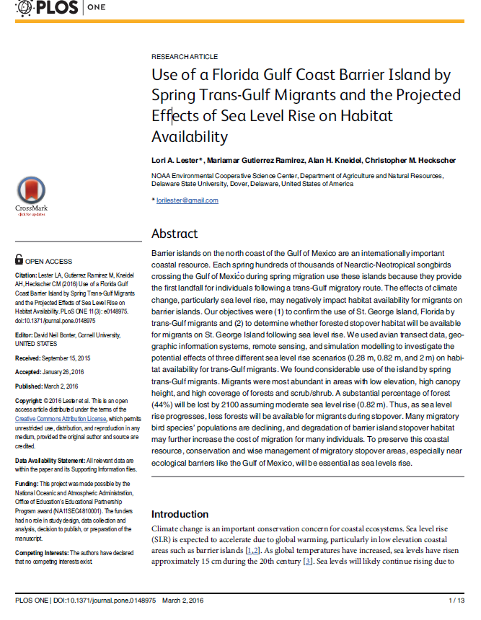
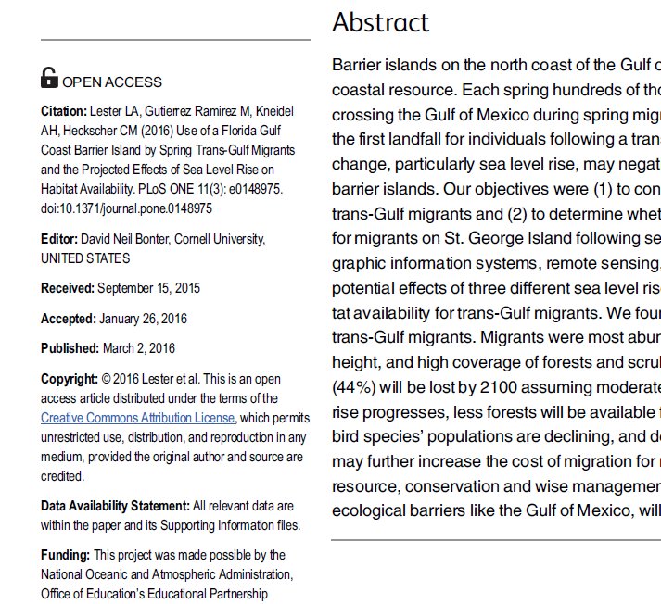

Slide 11
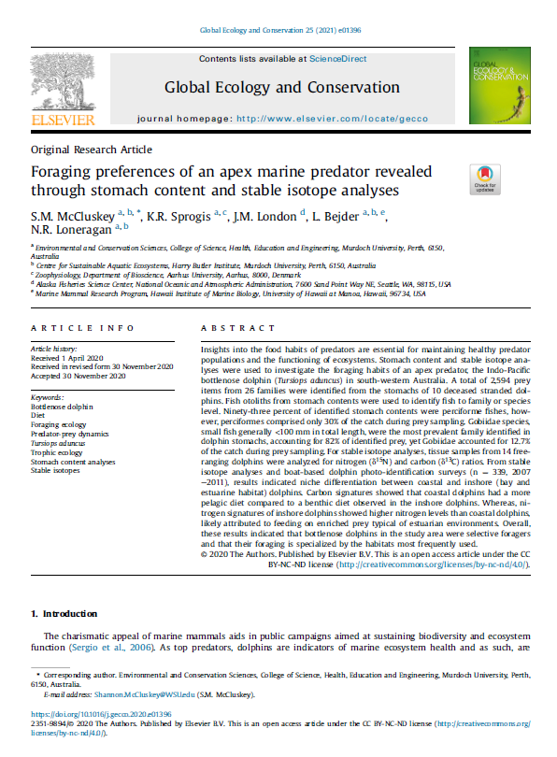

Slide 12
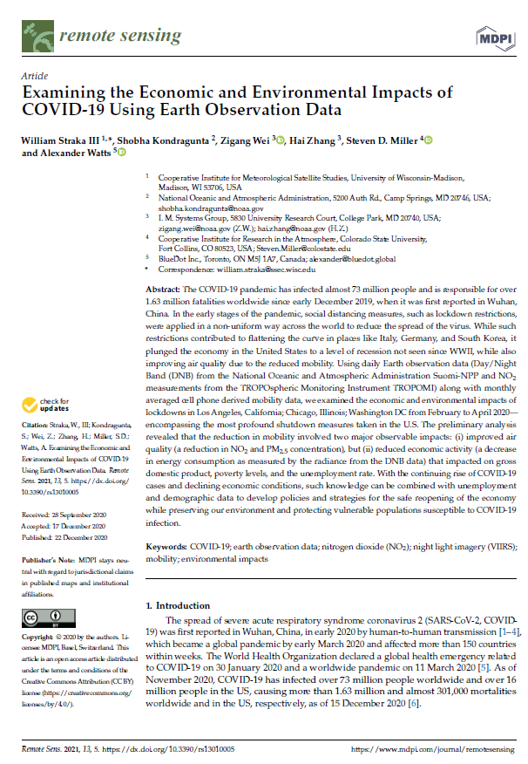
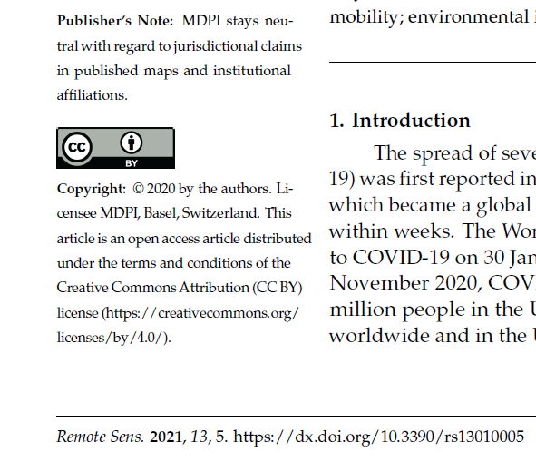

Slide 13
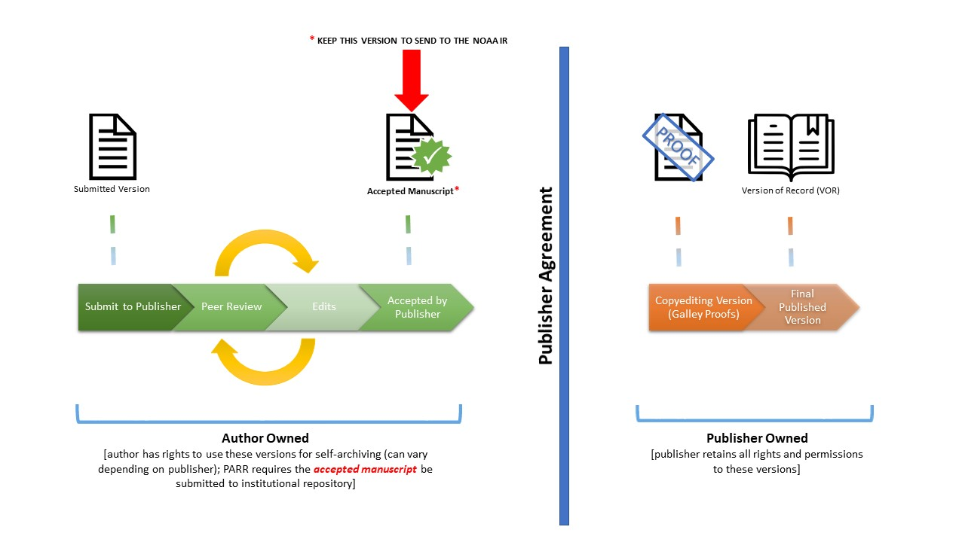
Image derived from Arthur Smith (2018)

Slide 14
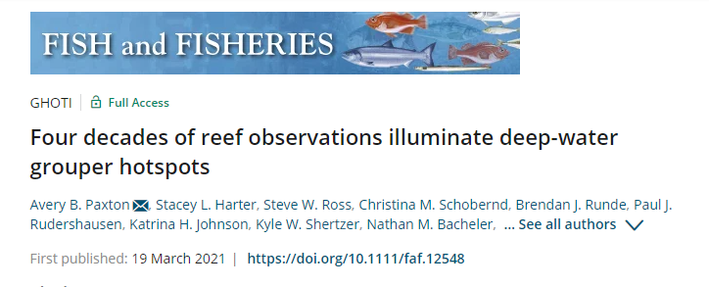
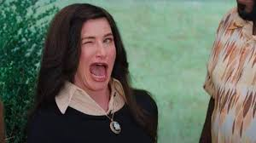
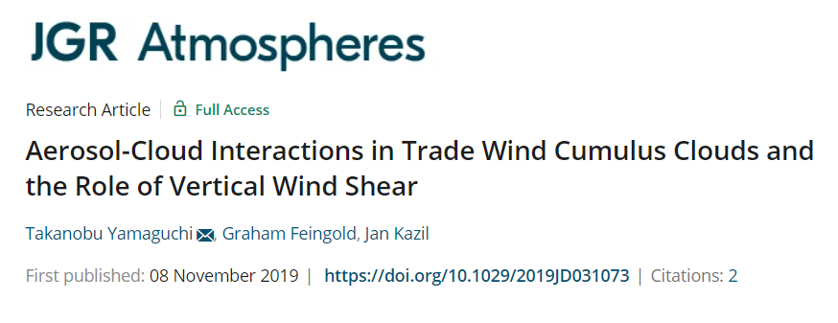
“Free/Full Access”
Notes:
Free or Full Access (Depends on the publisher which term is used) OR EDITORS CHOICE, indicates that the article is open for READING, and reading only. You can see it still has a copyright statement indicating the owner is Wiley & Sons. This would mean that we do not have the redistribution rights—and therefore cannot use this version of the document.
Why do publishers choose to do this? Drive traffic to their site.

Slide 15
“What if…”
“…I don’t know if my article is open access?”
Send it to the NOAA Library anyway! We will check the permissions and contact you if we are not able to use the version sent to us.
“…I can’t get a copy of the accepted manuscript, and you can’t take the VOR?”
Unfortunately this does happen, especially if you are not the first/corresponding author. In these instances we will not be able to include the publication in the NOAA IR, BUT these articles should still be reported to the National Sea Grant Program.

Slide 16
Section 508 Compliance
Required Elements: “The Big 5”
Tagged content
Figures, text, & tables tagged appropriately, etc.
Bookmarks
Alternative text for figures & images
Must be informative—describe the content
Document properties (title & language)
Logical reading order
Requires a manual check

Slide 17
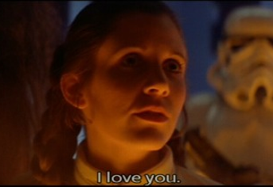
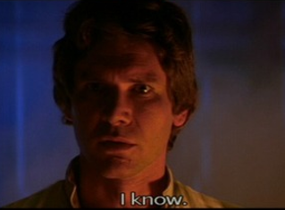
Journal Manuscript Remediation
Journal Manuscripts
NOAA IR team will remediate Accepted Manuscripts submitted to the NOAA IR
Submitters
IR Team
Notes:
`

Slide 18
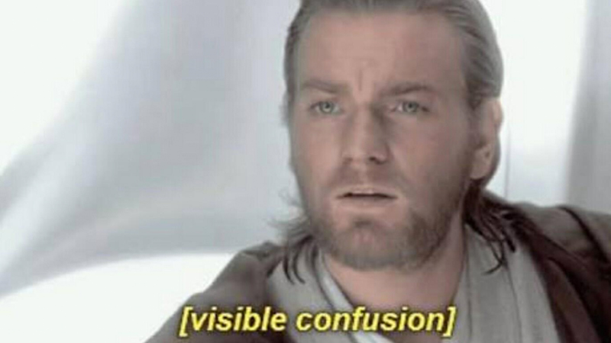
Accessibility Quirks & Hot Tips

Slide 19
Accessibility Quirks & Hot Tips
Transition from Word to Adobe
Creating a PDF from a Word document can often change the Alternate Text tagging to a random string of characters
Don’t Print to PDF, Use “Create PDF” option under the Acrobat tab

Slide 20
Accessibility Quirks & Hot Tips
Headers and Footers
Aren’t typically tagged in transition from Word to Adobe
If necessary to understand the document, you may have to tag it by hand
Captions and Alt Text
If a figure has a caption that is tagged as Text, you can just use the figure title or number as alt text
For Example: “Figure 1”

Slide 21
Accessibility Quirks & Hot Tips
Alternate Text
Alt text should describe the images that they represent
If something is very complicated (formula, graph, etc) you can use alt text to provide a generic email address for more information
Never use a personal email address
If an image is purely aesthetic, it can be designated as a “Decorative Figure” which will indicate to the screen reader it should be skipped

Slide 22
Section 508 Resources
NOAA Section 508 LibGuide
https://libguides.library.noaa.gov/Section508
NOAA Central Library You Tube Channel
Section 508 Playlist
How-to presentations, overviews, Q&A sessions, etc.
Full-length videos (45-60 minutes+)
Bite-Sized Videos: short (<3 minute) videos that focus on all areas of 508 compliance

Slide 23
QUESTIONS?
Jennifer.Fagan-fry@noaa.gov
noaa.repository@noaa.gov
Notes:
`

Slide 24
OA Licenses
Creative Commons Licensing: “standardized way to grant the public permission to use their creative work under copyright law.”
ALL CC licenses require credit be given to the author (BY)
CC BY*
Allows distribution, remixing, adapting, and building upon
Allows commercial use
CC BY-SA
Same as above
Derivative(s) must be “Shared Alike” (SA)
CC BY-NC
Allows distribution, remixing, adapting, and building upon
Only non-commercial use of work (NC)

Slide 25
OA Licenses
CC BY-NC-SA
Allows distribution, remixing, adapting, and building upon
Non-commercial use only (NC)
Adaptation must be “Shared Alike” (SA)
CC BY-ND
Allows for copying and distribution
No adaptations or derivatives (ND)
CC BY-NC-ND
Allows for copying and distribution
Non-commercial use only (NC)
No adaptations or derivatives (ND)

Slide 26
Embargoes Explained: What they are
A mechanism for publishers to restrict access to publications for a duration of time
Most common embargo periods are between 6 and 12 months in STEM
Can be upwards of 24 months or more in the social sciences/humanities
Can be levied on manuscript version or the publisher’s version
Based on publisher’s archiving policies which version is embargoed

Slide 27
Embargoes Explained: Misconceptions
MYTH: Once the Embargo is over, I can use the publisher’s version freely
Not necessarily. Embargoes are levied on the version of the publication that is available for archiving
Often times, embargoes are for the accepted manuscript version
MYTH: I have to wait to submit my publication to the IR until the embargo is over
NOPE! The IR can manage the embargo for you
Plus, PARR requires you submit within 12 months of publication—meaning that if the embargo is 12+months it would be late

Slide 28
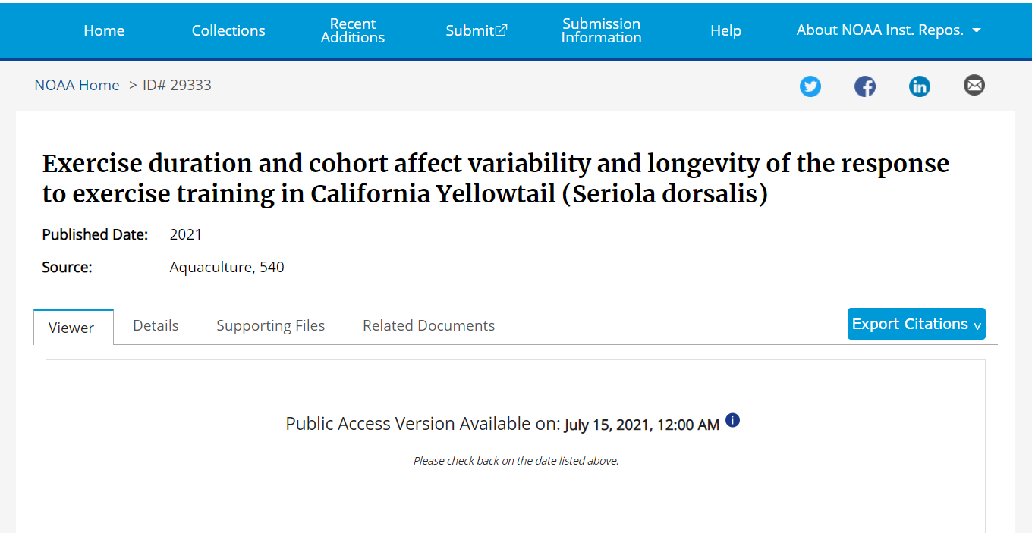
Embargoes Explained: Enforcement
The NOAA IR
System will provide metadata for item during the embargo with link to the publisher version
Document (whether it is the publisher’s version or the AM) will automatically become available
Notes:
No need to hold the publication until the end of the embargo period, we do that for you.

