Slide 1
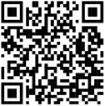
Attention, graduate students & recent grads...
Apply for the John A. Knauss Marine Policy Fellowship!
Knauss fellows work on ocean, coastal and Great Lakes policy issues in
our nation’s capital
Fellows gain experience translating science knowledge to policy
actions through year-long, paid placements in legislative and
executive branch host offices
50% of fellowship alumni work for the federal government
Submit
materials to
___ Sea Grant
by February 15, 2024
bit.ly/knauss-fellowship

